Slide 1
IoT Project
Robot Motion using Voice
Section - 20BCS18 B
Group No. - 3
Shivansh Singh (20BCS3101)
KRISHMA . (20BCS3103)
Bhavesh Singh Yadav (20BCS3136)
Arya Bhattacharyya (20BCS3161)

Slide 2
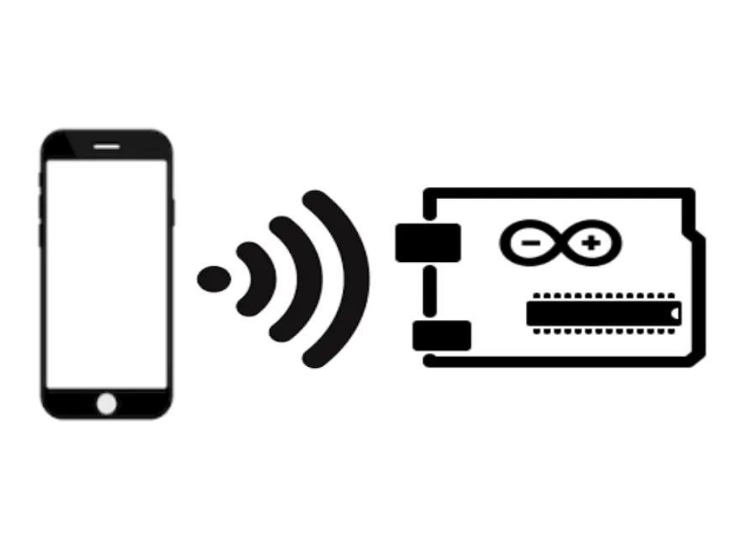
Problem Statement
Developing a smart phone application to wirelessly control robot motion using voice.

Slide 3
Features
Voice Control
Android Application
Control the movements of the robot using voice commands
A well defined application to send the commands to the hardware module
Value Chart
A value table to reference the commands sent according to their given values
Ubidots Dashboard
A well defined dashboard to visualize the data sent to the module

Slide 4



Process Flow
The Android application takes input from the user using voice commands
The application send the commands to Ubidots which reflects as integers ranging from 0-5.
Ubidots sends the values to the hardware module, which processes them and performs the motion, accordingly.

Slide 5
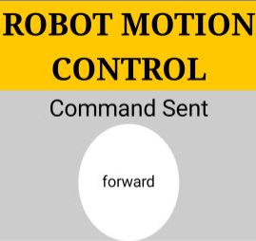
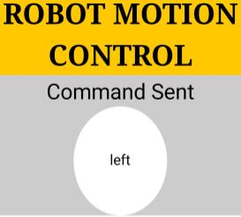
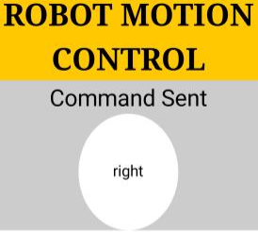
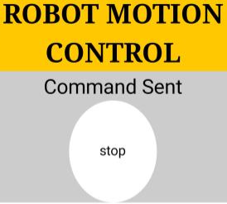
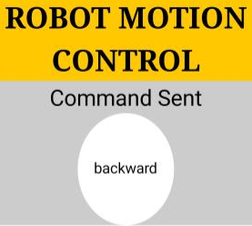
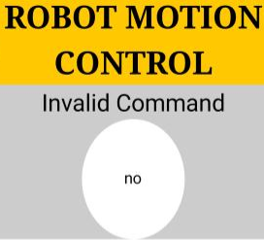
Commands
01
02
03
04
05
06

Slide 6
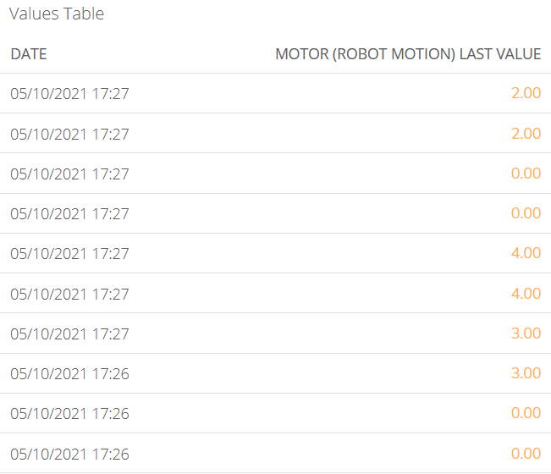
Variable Table

Slide 7
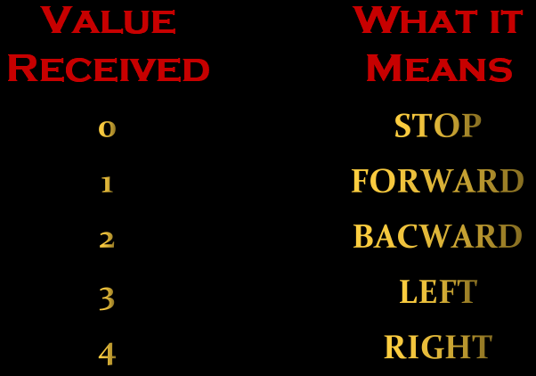
Value Chart

Slide 8
conclusion
using this app we can control the motion of the robot by just usign voice commands
since it is made for android users , it has a good commercial value as it will reach out to greater masses
it is convenient to use and modify as per the needs of the user.

Slide 9


